Slide 1
Functions
Mr Mack 2021

Slide 2
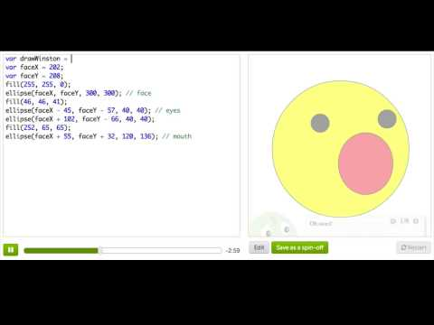
Functions

Slide 3
Practice: Say Your Name
This program says hi to you at a random point on the screen. Change the name variable so it says your name instead.
Hint: Your name should be a string, so make sure you keep it inside "quotation marks".
What's your name?

Slide 4
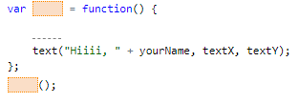
Practice: Say Your Name
It's time to wrap your code in a function:
- Start off by creating a new function, paying close attention to (parenthesis) and {curly braces} ;
- Move all of your code inside the function;
- Call your new function once to make sure it works.
Bonus: Indent the code inside the function, by selecting it and clicking TAB. It doesn't change the result, but it makes the code look nicer and easier to read ^ . ^
Function-ize it!

Slide 5

Practice: Say Your Name
Now that we have it in a function, it's easy for us to call it multiple times. Call it at least 3 more times! Names everywhere!
Keep calling it!

Slide 6
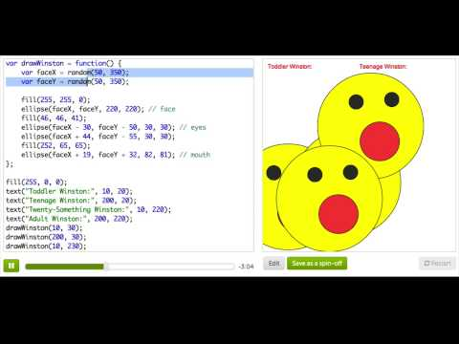
Function Parameters

Slide 7

Practice: Moles in Holes
Our grass is filled with holes, but has no moles. Thankfully, we've already defined a mole drawing function, drawMole, so that all you have to do to get a mole to show up is call that function.
Try it out ! Call the drawMole function to make a mole show up.
Draw a mole!

Slide 8


Practice: Moles in Holes
Right now, our drawMole function will draw a mole in the same place every time we call it. We want to be able to tell the drawMole function where to draw the mole, so that, each time we call the drawMole function the mole can be drawn in a different place.
Add two parameters to the drawMole function, to tell it where to draw the mole:
- one for the x position
- the other for the y position
After you have modified the drawMole function, test it out:
- On the previous step, you called drawMole() without any arguments. Now, pass two arguments into that call, so that it draws the mole in the middle of the center hole.
Parameter-ize the mole

Slide 9
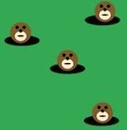
Practice: Moles in Holes
Now that you made that change, it's easy to add more moles. Call the function three more times, and pass values in that make the moles show up in the holes.
MORE moles!

Slide 10
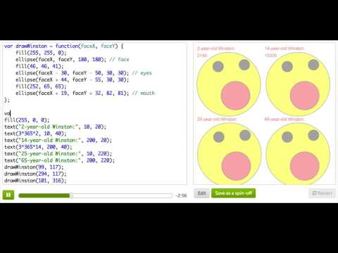
Function Return Values

Slide 11
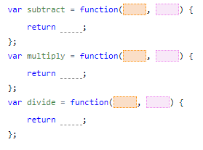
Practice: Calculator
This program shows the results of adding, subtracting, multiplying, and dividing some numbers... but only the addition calculations are correct. To make all the calculations correct, change what the other three functions do so that:
- subtract returns the difference between the two arguments;
- multiply returns the product of the two arguments;
- divide returns the quotient between the two arguments;
Fix our calculations!

Slide 12
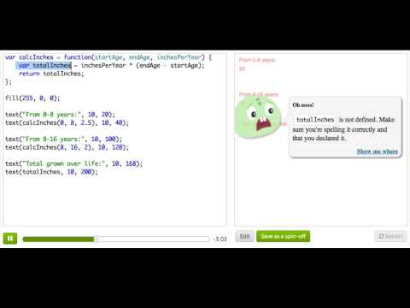
Local and Global Variables

Slide 13
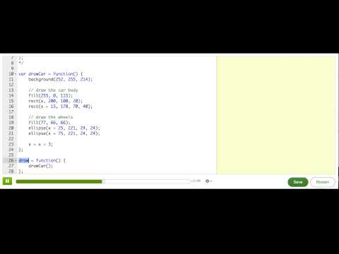
Special ProcessingJS functions

Slide 14
Review: Functions
This is a review of what we covered in this tutorial on functions.
We often want to be able to re-execute blocks of code when we are writing programs, without having to re-write the block of code entirely. We need a way of grouping code together and giving it a name, so that we can call it by that name later, and that's what we call a function.
To create a function, we must first declare it and give it a name, the same way we'd create any variable, and then we follow it by a function definition:
var sayHello = function() {
};

Slide 15
Review: Functions
We could put any code inside that function - one statement, multiple statements - depends on what we want to do. In this function, we could just output a message at a random location:
var sayHello = function() {
text("Halllllllo!", random(200), random(200));
};

Slide 16
Review: Functions
Now, if all we do is declare the function, nothing will happen. In order for the program to execute the code that's inside the function, we actually have to "call" the function, by writing its name followed by empty parentheses:
sayHello();
And then we could call it whenever we wanted, as many times as we wanted!
sayHello();
sayHello();
sayHello();

Slide 17
Review: Functions
We often want to be able to customize functions, to tell the program "well, do all of this code, but change a few things about how you do it." That way we have code that is both reusable and flexible, the best of both worlds. We can achieve that by specifying "arguments" for a function, using those arguments to change how the function works, and passing them in when we call the function.
For example, what if we wanted to be able to say exactly where we want the message displayed, just like we can say exactly where we want to draw rect()s and ellipse()s? We could imagine calling it like so, to put the message at two precise coordinates:
sayHello(50, 100);
sayHello(150, 200);

Slide 18
Review: Functions
To make that work, we need to change our sayHello function definition so it knows that it will receive 2 arguments, and then uses them inside:
var sayHello = function(xPos, yPos) {
text("Halllllllo!", xPos, yPos);
};

Slide 19
Review: Functions
The arguments that get passed in basically become like variables inside your function definition, and the names depend on what you call them in the parentheses. We could just as easily rename them to something shorter:
var sayHello = function(x, y) {
text("Halllllllo!", x, y);
};

Slide 20
Review: Functions
Our functions can accept any number of arguments - zero, one, two, or more. We could have also decided that we wanted to change our function to accept a name to say hello to:
var sayHello = function(name) {
text("Halllllllo, " + name, random(200), random(200));
};
And then we would have called it like so:
sayHello("Winston");
sayHello("Pamela");

Slide 21
Review: Functions
We could combine those ideas, and have it accept three arguments, for the name and position:
var sayHello = function(name, x, y) {
text("Halllllllo " + name, x, y);
};
And then call it like so:
sayHello("Winston", 10, 100);
Notes:
It really depends on what you want your functions to do, and how much you want to customize what they can do. You can always start off with no arguments, and then add more as you realize you need them.
Now, you've actually been calling functions this whole time - that's how you've been making drawings and animations - like with rect, ellipse, triangle, etc. All of those functions are ones that come from the ProcessingJS library, and we load them into every program that you make here, so that you can always use them. We've defined the functions for you, because we thought they'd be useful, and now it's up to you to decide what custom functions you want to use in your own programs. For example, we provide the ellipse function, but we don't provide a cat function - if your program involves a lot of different cats in different locations, maybe you should create your own cat function!

Slide 22
Review: Functions
There's another powerful thing we can do with functions - we can use them to take in some values, compute them, and return a new value. Think about all the things you can do with a calculator - add values, subtract, calculate square root, multiply, etc. All of those would be done with functions that took in the input and output the result. The functions would take in the input as arguments and output the result using a return statement. Here's a function that adds two numbers and returns the result:
var addNumbers = function(num1, num2) {
var result = num1 + num2;
return result;
};
var sum = addNumbers(5, 2);
text(sum, 200, 200); // Displays "7"

Slide 23
Review: Functions
The return statement does two things: it gives a value back to whoever called it (which is why we could store it in the sum variable), and it immediately exits the function. That means it'd be silly if we had something like this, because that last line would never get executed:
var addNumbers = function(num1, num2) {
var result = num1 + num2;
return result;
result = result * 2; // silly!
};

Slide 24
Review: Functions
Functions with return values are quite useful for manipulating data in programs, and they can be combined together in expressions, too:
var biggerSum = addNumbers(2, 5) + addNumbers(3, 2);
You can even call functions inside function calls, although that can get hard to read at times:
var hugeSum = addNumbers(addNumbers(5, 2), addNumbers(3, 7));

Slide 25
Review: Functions
Now that you know how to create functions that wrap around blocks of code, we have to bring up an important concept: local variables versus global variables.
When we declare a new variable inside a function, we say that it is local to that function. That's because only that function can see that variable - the rest of the program outside of it cannot. Once we're outside that function, it's like it no longer exists. In the following function, localResult is a local variable:
var addNumbers = function(num1, num2) {
var localResult = num1 + num2;
println("The local result is: " + localResult);
return localResult;
};
addNumbers(5, 7);
println(localResult); // oh noes!

Slide 26
Review: Functions
When we run that code, we'll get an error on the final line: "localResult is not defined." The variable is only defined inside the function, because that's where we declared it with the var localResult = line, and is not defined outside of it.
When we declare a variable outside our functions, we say that it is a global variable. That's because all functions can now access it and do whatever they want with it.
var globalResult;
var addNumbers = function(num1, num2) {
globalResult = num1 + num2;
println("The global result is: " + globalResult);
};
addNumbers(5, 7);
println(globalResult);

Slide 27
Review: Functions
⚠️ You might be tempted to use global variables for everything, since you'll never get an error that they're undefined. But actually, global variables are a common source of hard-to-find errors. In larger programs or collaborative programs, it’s easy to lose track of where and how you (or others!) used those global variables. When possible, use local variables.
Every programming language is different, but for JavaScript, it's important to know that variables have "function scope" - a function can see the local variables that were declared inside of it and the global variables that were declared outside of it, but it cannot see the local variables inside other functions.

Slide 28
Challenge: Fish tank
Create a custom function (like drawFish) that draws a fish. You can build on the starter code or start from scratch.
Add at least 2 parameters to the function declaration that control either the position or the size of the fish.
Now call that function many times, with different values as arguments, so that your screen is filled with fish.
Bonus: Add more parameters to the function declaration, like color, tail width, eye size, tail color—more ways that you can make each fish different from each other.
Bonus: Add seaweed to the tank, pebbles at the bottom, or bubbles floating to the top. Whatever objects you add, make a function to draw them at different places.
Bonus: Want to make it interactive? Use a mouseClicked function to add more fish wherever the user clicks.
This program draws a single fish. Poor lonely fish! For this project, you'll use functions to accompany him with more fish of all different shapes and colors.

